Slide 1




University Institute of Engineering
Department of Computer Science & Engineering
COMPUTER ORGANIZATION & ARCHITECTURE
(23CST-204/23ITT-204)
ER. SHIKHA ATWAL
E11186
ASSISTANT PROFESSOR
BE-CSE

Slide 2
I/O PROCESSORS
Processor with direct memory access capability that communicates with I/O devices
Channel can execute a Channel Program
Stored in the main memory
Consists of Channel Command Word (CCW)
Each CCW specifies the parameters needed by the channel to control the I/O devices and perform data transfer operations
CPU initiates the channel by executing a channel I/O class instruction and once initiated, channel operates independently of the CPU

Slide 3
A computer may incorporate one or more external processors and assign them the task of communicating directly with the I/O devices so that no each interface needs to communicate with the CPU.
An I/O processor (IOP) is a processor with direct memory access capability that communicates with I/O devices.
IOP instructions are specifically designed to facilitate I/O transfer. The IOP can perform other processing tasks such as arithmetic logic, branching and code translation.

Slide 4
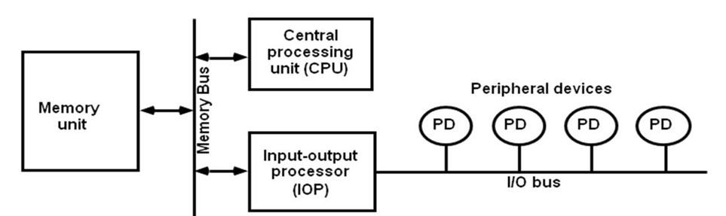
Block diagram of a computer with I/O Processor
The memory unit occupies a central position and can communicate with each processor by means of direct memory access. The CPU is responsible for processing data needed in the solution of computational tasks. The IOP provides a path for transferring data between various peripheral devices and memory unit.

Slide 5
In most computer systems, the CPU is the master while the IOP is a slave processor.
The CPU initiates the IOP and after which the IOP operates independent of CPU and transfer data between the peripheral and memory.
For example, the IOP receives 5 bytes from an input device at the device rate and bit capacity. After which the IOP packs them into one block of 40 bits and transfer them to memory. Similarly, the O/P word transfer from memory to IOP is directed from the IOP to the O/P device at the device rate and bit capacity.

Slide 6
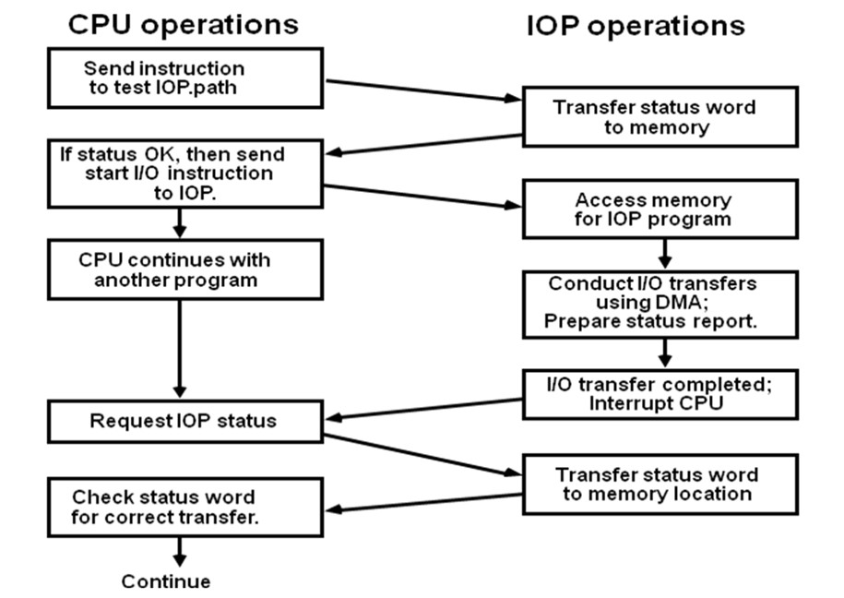
CPU – IOP COMMUNICATION
The memory unit acts as a message center where each processor leaves information for the other. The operation of typical IOP is appreciated with the example by which the CPU and IOP communication.
CPU – IOP communication

Slide 7
The CPU sends an instruction to test the IOP path.
The IOP responds by inserting a status word in memory for the CPU to check.
The bits of the status word indicate the condition of the IOP and I/O device, such as IOP overload condition, device busy with another transfer or device ready for I/O transfer.
The CPU refers to the status word in in memory to decide what to do next.
If all right up to this, the CPU sends the instruction to start I/O transfer.
The CPU now continues with another program while IOP is busy with I/O program.
When IOP terminates the execution, it sends an interrupt request to CPU.
CPU responds by issuing an instruction to read the status from the IOP.
IOP responds by placing the contents to its status report into specified memory location.
Status word indicates whether the transfer has been complete or with error.

Slide 8
DATA COMMUNICATION PROCESSOR
Distributes and collects data from many remote terminals connected through telephone and other communication lines.
Transmission:
Synchronous
Asynchronous
Transmission Error:
Parity
Checksum
Cyclic Redundancy Check
Longitudinal Redundancy Check

Slide 9
Transmission Modes:
Simples
Half Duplex o Full Duplex
Data Link & Protocol
A data communication (command) processor is an I/O processor that distributes and collects data from remote terminals connected through telephone and other communication lines. In processor communication, processor communicates with the I/O device through a common bus i.e., data and control with sharing by each peripherals. In data communication, processor communicates with each terminal through a single pair of wires.

Slide 10
The way that remote terminals are connected to a data communication processor is via telephone lines or other public or private communication facilities. The data communication may be either through synchronous transmission or through asynchronous transmission. One of the functions of data communication processor is check for transmission errors. An error can be detected by checking the parity in each character received. The other ways are checksum, longitudinal redundancy check (LRC) and cyclic redundancy check (CRC).
Data can be transmitted between two points through three different modes. First is simplex where data can be transmitted in only one direction such as TV broadcasting. Second is half duplex where data can be transmitted in both directions at a time such as walkie-talkie. The third is full duplex where data can be transmitted in both directions simultaneously such as telephone.

Slide 11
The communication lines, modems and other equipment used in the transmission of information between two or more stations is called data link. The orderly transfer of information in a data link is accomplished by means of a protocol.

Slide 12
References
Reference Books:
J.P. Hayes, “Computer Architecture and Organization”, Third Edition.
Mano, M., “Computer System Architecture”, Third Edition, Prentice Hall.
Stallings, W., “Computer Organization and Architecture”, Eighth Edition, Pearson Education.
Text Books:
Carpinelli J.D,” Computer systems organization &Architecture”, Fourth Edition, Addison Wesley.
Patterson and Hennessy, “Computer Architecture”, Fifth Edition Morgaon Kauffman.

Slide 13
Other References
http://www.ecs.csun.edu/~cputnam/Comp546/Input-Output-Web.pdf
http://www.ioenotes.edu.np/media/notes/computer-organization-and-architecture- coa/Chapter7-Input-Output-Organization.pdf
https://www.geeksforgeeks.org/io-interface-interrupt-dma-mode/
I/O Interface (Interrupt and DMA Mode) - GeeksforGeeks

